Slide 1
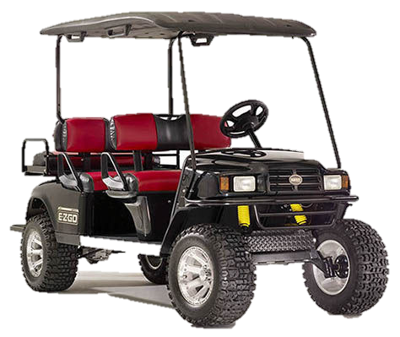
Texas A&M University Environmental Health & Safety
Slow Moving Vehicle (SMV) Training
Notes:
Howdy, Welcome to the Texas A&M University Environmental Health & Safety, Slow Moving Vehicle (SMV) Program.
This training is approximately 20 minutes in length.

Slide 2
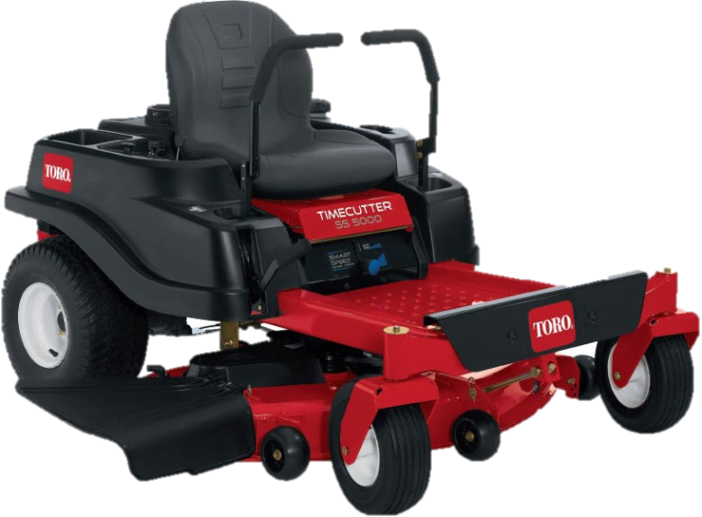
Introduction
This training supplements the University SAP (Standard Administrative Procedures) on SMVs which establishes proper safety procedures, identification, registration, parking, routes, and access for SMVs on or off university property.
Notes:
This training supplements the University SAP on Slow Moving Vehicle’s which establishes proper safety procedures, identification, registration, parking, routes and access for Slow Moving Vehicle’s on or off university property.

Slide 3
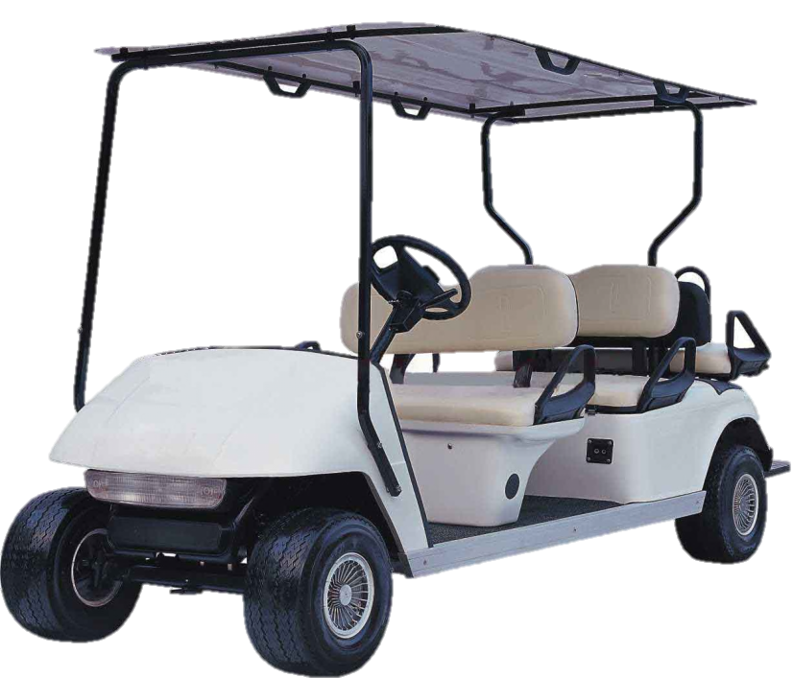
Intent
The intent is to provide a safe environment for students, faculty, staff, and visitors.
Notes:
The intent is to provide a safe environment for students, faculty, staff, and visitors while on the Texas A&M University Campus

Slide 4
SMVs are Identified by:
Having no less than four wheels
Obtaining a maximum speed of 25 mph
Used by departments, contractors, and private partners to move people and/or materials around campus
This applies to either electric or gas-powered SMVs
Notes:
Utility type vehicles which have no less than four wheels, obtain a maximum speed of 25 mph, and are used by departments, contractors, and private partners to move people and/or materials around campus. This applies to either electric or gas-powered Slow Moving Vehicles.

Slide 5
SMVs include the following
Notes:
Slow Moving Vehicles included in this program are:

Slide 6
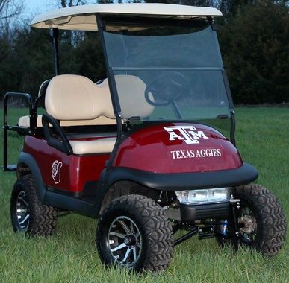
Golf Cart
Notes:
Golf Cart

Slide 7
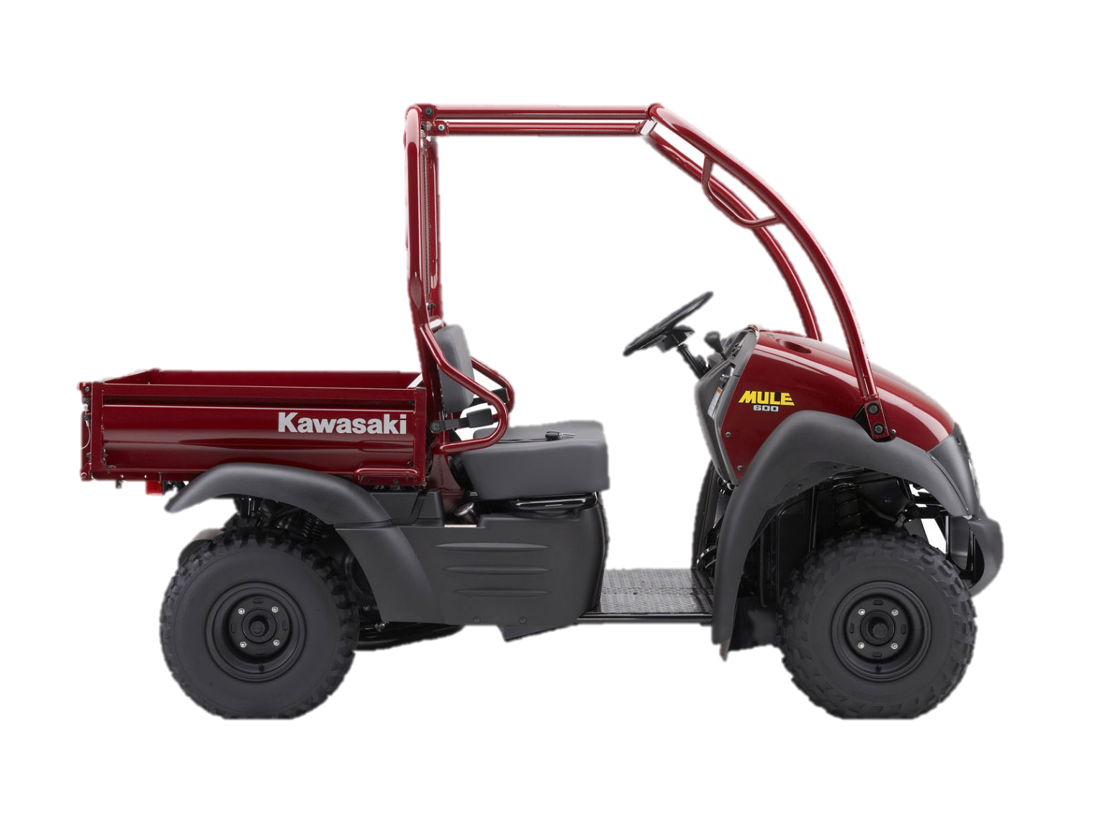
Kawasaki Mule
Notes:
Kawasaki Mule

Slide 8
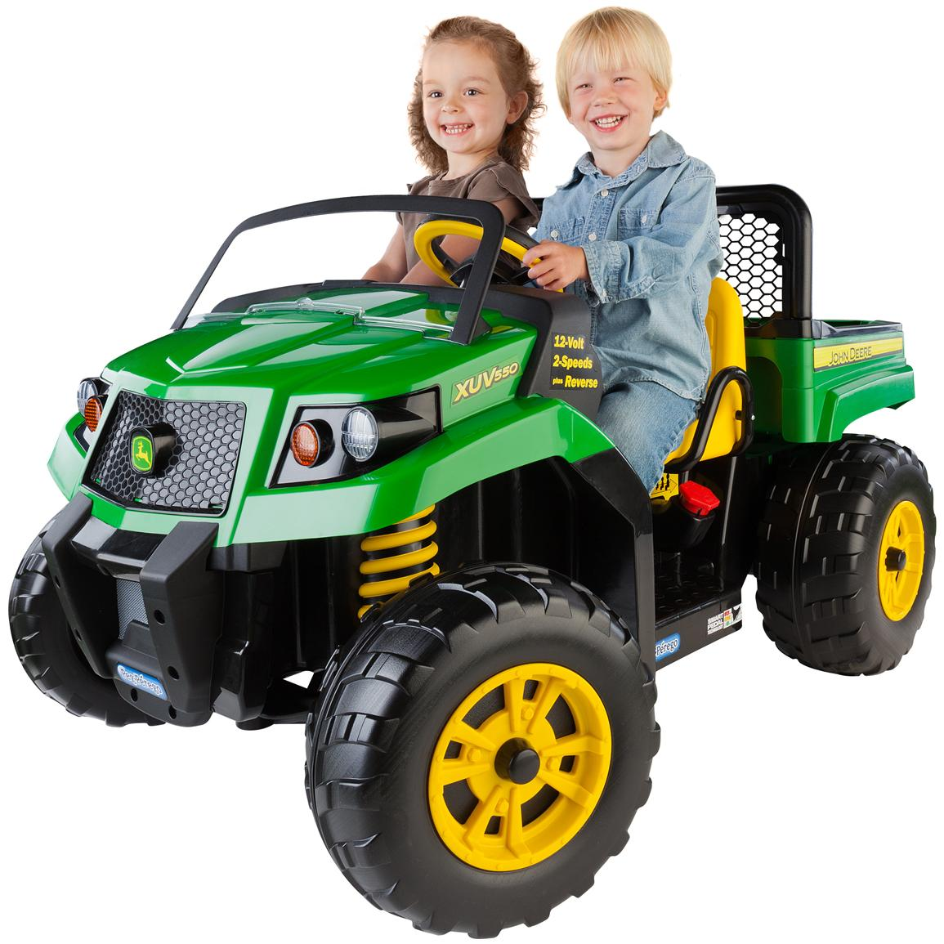
John Deere Gator
Notes:
John Deere Gator

Slide 9
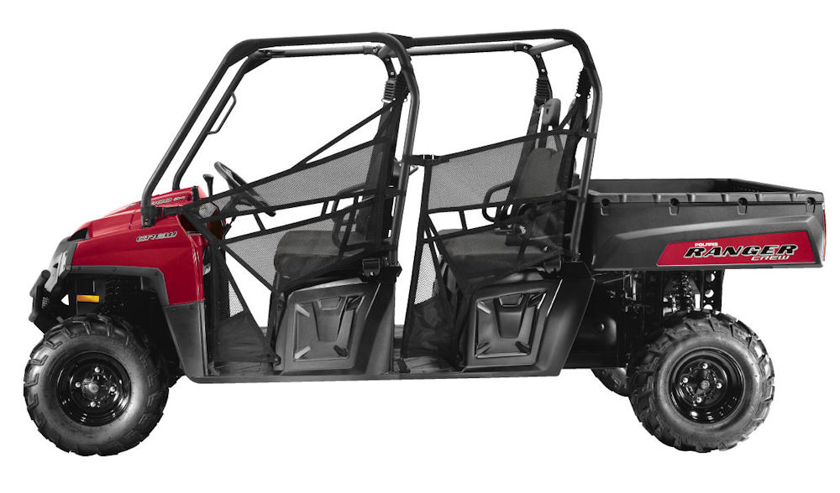
Polaris Ranger
Notes:
Polaris Ranger

Slide 10
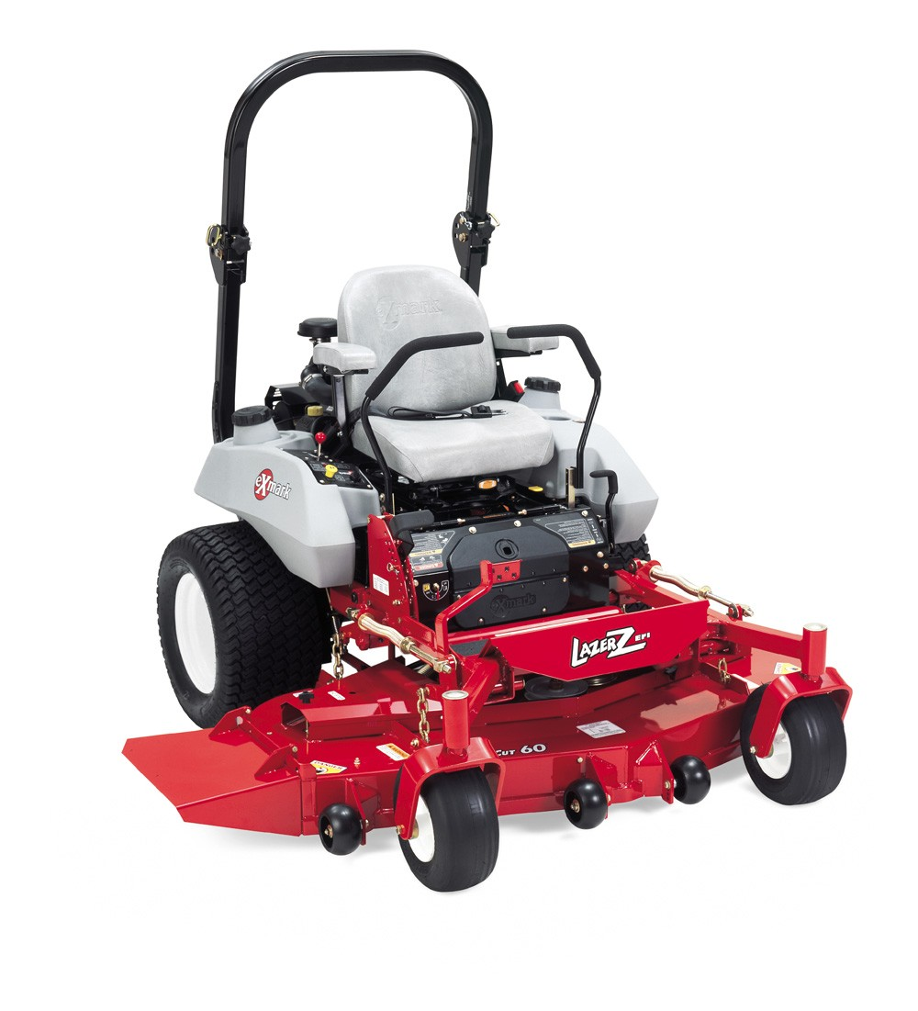
Zero-turn Mower
Notes:
Zero-turn Mower

Slide 11
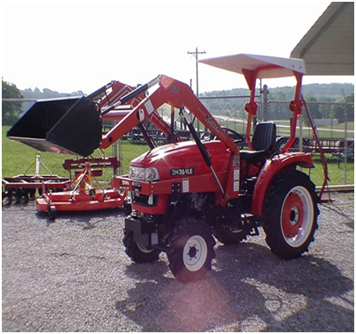
Utility Tractor
Notes:
Utility Tractor

Slide 12
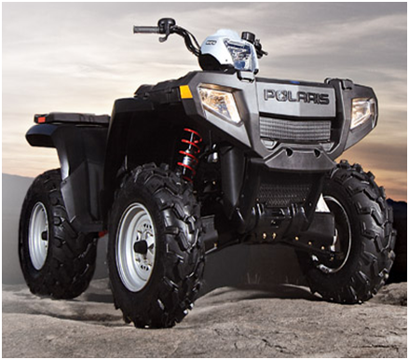
Four-Wheeler
Notes:
Four-Wheeler

Slide 13

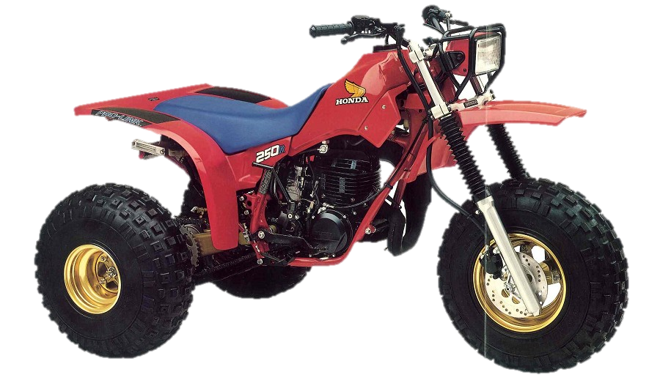
No Three-Wheelers
Three-wheelers are not to be used on campus due to safety hazards associated with this type of vehicle.
Notes:
Three-wheelers are not to be used on campus due to safety hazards associated with this type of vehicle.

Slide 14
Topics
Requirements before operating SMV
Vehicle identification & Registration
Restrictions
Required equipment found on SMVs
Recommended equipment for SMVs
Safety Procedures
Maintenance
Parking on campus
Routes on campus
Access for SMVs
Notes:
The topics include vehicle Requirements before operating SMV:
Vehicle identification & Registration
Restrictions
Required equipment found on SMVs
Recommended equipment for SMVs
Safety Procedures
Maintenance
Parking on campus
Routes on campus
Access for SMVs
for Slow Moving Vehicle’s.

Slide 15
Requirements
Before operating a SMV on Texas A&M University property, operators must:
Possess a valid US driver’s license
Know and adhere to the State of Texas motor vehicle laws
Complete this training regarding the safe operation of SMVs
Training is required every two years and documentation will be captured through TrainTraq
Notes:
Requirements before operating a Slow Moving Vehicle on Texas A&M University property, operators must:
Possess a valid US driver’s license, know and adhere to the State of Texas motor vehicle laws, and complete this training regarding the safe operation of Slow Moving Vehicles. Training is required every two years and documentation will be captured through TrainTraq.

Slide 16
Vehicle Identification and Registration
SMVs used on TAMU property and university/public roadways must have the following university-required markings obtained from Transportation Services (TS)
Vehicle number
Department name
Optional department logo
An approved temporary-use permit SMV marking can be acquired from TS.
Notes:
Vehicle identification and registration for Slow Moving Vehicle’s used on university property and university/public roadways must have university-required markings obtained from Transportation Services (TS) including vehicle number and department name. Additional markings, such as department logo may be added. An approved temporary-use permit Slow Moving Vehicle marking can be acquired from Transportation Services.

Slide 17
Vehicle Identification and Registration
SMVs must be equipped with certain features (SMV acquired before the effective date of the SMV SAP must comply by December 31, 2014), including but not limited to:
Notes:
Slow Moving Vehicles must be equipped with certain features (Slow Moving Vehicles acquired before the effective date of the Slow Moving Vehicle SAP must comply by December 31, 2014) this includes but not limited to.

Slide 18
Restrictions
SMVs not licensed via Texas traffic code must be fitted by the manufacturer with a governor to not exceed 25 mph
Personally owned SMVs are prohibited from operating on University property
University owned SMVs are for University business only
Personal mobility devices are not classified as a SMV
Notes:
These restrictions will apply, Slow Moving Vehicle not licensed via Texas traffic code must be fitted by the manufacturer with a governor to not exceed 25 mph. Personally-owned Slow Moving Vehicle’s are prohibited from operating on University property, and University owned Slow Moving Vehicles are for University business only. However personal mobility devices are not classified as a Slow Moving Vehicle.

Slide 19
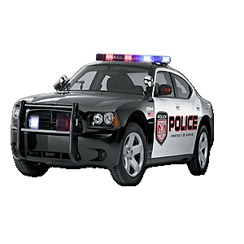
Restrictions
Modification or tampering with a SMV governor is prohibited and is a violation of Federal Law.
Notes:
Modification or tampering with a Slow Moving Vehicle governor is prohibited and is a violation of Federal Law.

Slide 20
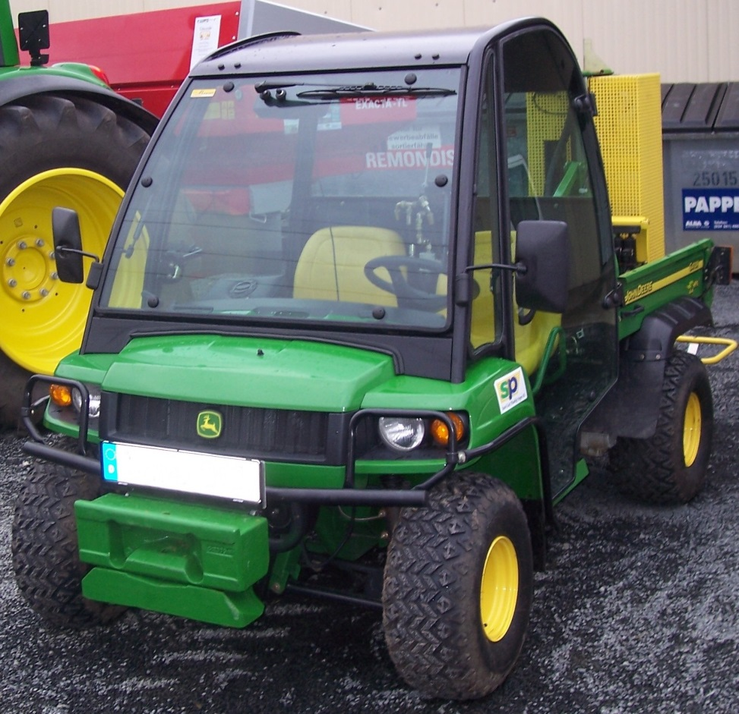
Required
Front turn signals
Headlights (2), if operated after dusk or before dawn
Mirrors: must have
one of the following
Rear view drivers side
Interior rear view
The Zero-turn mower is excluded from these three requirements.
Notes:
Required
Front turn signals
Headlights (2), if operated after dusk or before dawn
Mirrors- must have one of the following: rear view drivers side or interior rear view
The Zero-turn mower is excluded from these three requirements.

Slide 21
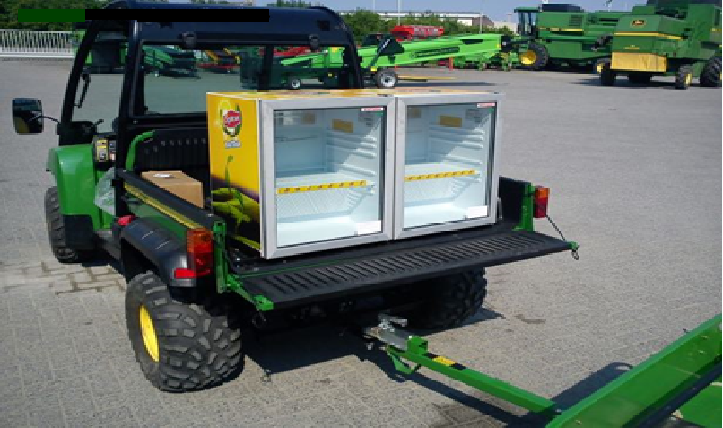

Required
Rear turn signals
Rear stoplights/tail lamps
Slow moving triangle
The Zero-turn mower is excluded from these requirements but must have a slow-moving triangle.
Notes:
Required
Rear turn signals
Rear stoplights/tail lamps
Slow moving triangle
The Zero-turn mower is excluded from these requirements but must have a slow moving triangle.

Slide 22
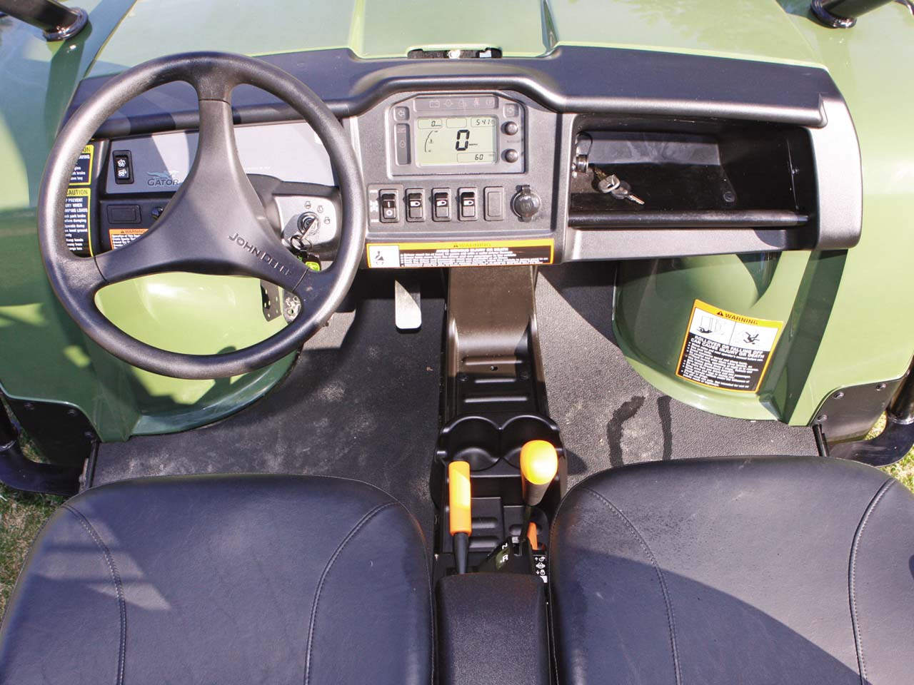
Required
Ignition/on-off key to prevent unauthorized use
Parking brake
Notes:
Required
Ignition/on-off key to prevent unauthorized use
Parking brake

Slide 23

Recommended
Front flashing hazard lights
Windshield
Strobe/beacon light
Seatbelts (may not be optional on some SMV’s)
Notes:
Recommended
Front flashing hazard lights
Windshield
Strobe/beacon light
Seatbelts (may not be optional on some Slow Moving Vehicles)

Slide 24
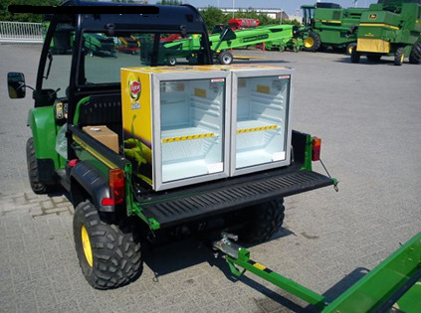
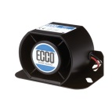

Recommended
Rear flashing hazard lights
Audible back-up alarm
Strobe/beacon light
Notes:
Recommended
Rear flashing hazard lights
Audible back-up alarm
Strobe/beacon light

Slide 25
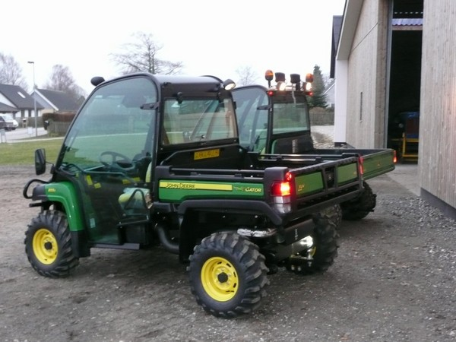
Recommended
Horn
Doors/steering wheel locks
Notes:
Recommended
Horn
Doors/steering wheel locks

Slide 26
Safety
The following outlines procedures
for the safe operation of SMVs.
Notes:
Safety
The following outlines procedures for the safe operation of Slow Moving Vehicles:

Slide 27
Safety
Familiarize yourself with the controls used to start, brake, accelerate, and backup the SMV. These functions will differ from one SMV to another.
Notes:
Familiarize yourself with the controls used to start, brake, accelerate, and backup the Slow Moving Vehicle; these functions will differ from one Slow Moving Vehicle to another.

Slide 28
Safety
Never operate the SMV under the influence of drugs or alcohol
Do not operate If taking prescribed medication that causes drowsiness or other impairment
Communicate with your supervisor if unable to drive the SMV
Notes:
Never operate the Slow Moving Vehicle under the influence of drugs or alcohol. If taking prescribed medication that causes drowsiness or other impairment, communicate with your supervisor if you are unable to drive the Slow Moving Vehicle.

Slide 29
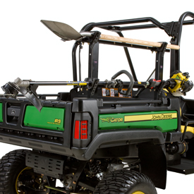
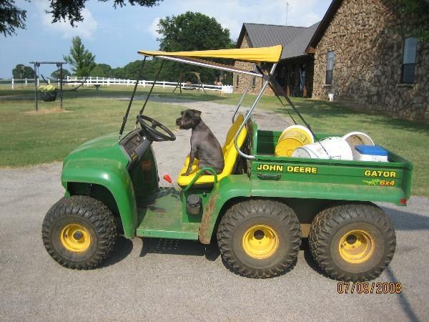
Safety
Secure and properly store all equipment and supplies to prevent objects from falling out or striking people.
Notes:
Secure and properly store all equipment and supplies to prevent objects from falling out or striking people.

Slide 30
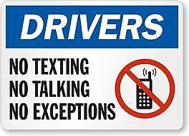

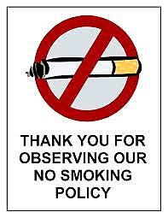
Safety
Never smoke, use cell phones, headphones, or other devices that could limit hearing or cause a distraction while operating the SMV.
Notes:
Never smoke, use cell phones, headphones, or other devices that could limit hearing or cause a distraction while operating the Slow Moving Vehicle.

Slide 31
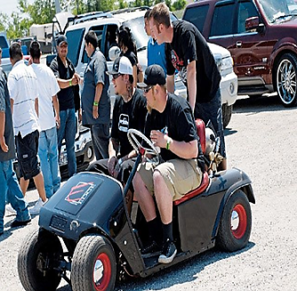
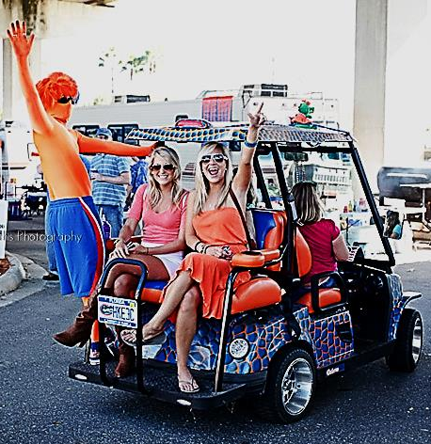
Safety
SMVs must not be overloaded (e.g., carrying more passengers than seating provided or overloading the SMV’s recommended carrying or load capacity).
Seat belts must be used when provided.
Notes:
Slow Moving Vehicle’s must not be overloaded, e.g., carrying more passengers than seating provided or overloading the Slow Moving Vehicle’s recommended carrying or load capacity (Seat belts must be used when provided).

Slide 32

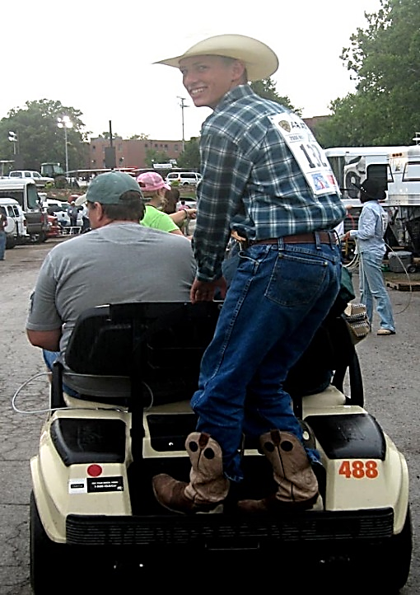
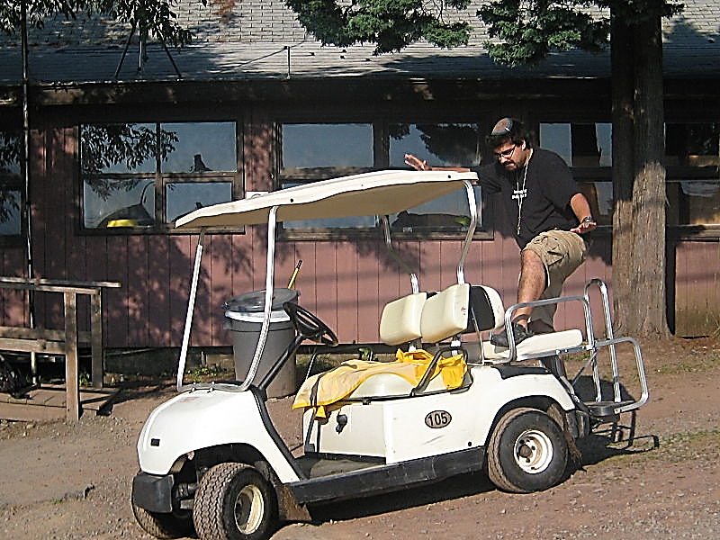


Safety
No one is permitted to ride on the running boards, fenders, or any part of the SMV except the seats in a sitting position.
Notes:
No one is permitted to ride on the running boards, fenders, or any part of the Slow Moving Vehicle except the seats except in a sitting position.

Slide 33
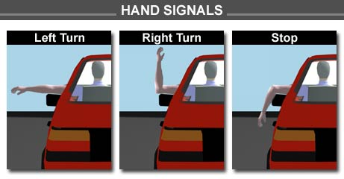
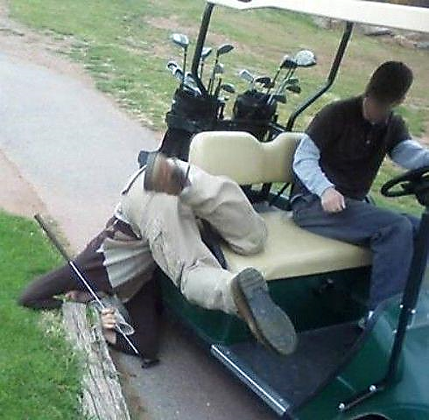
Safety
All body parts – feet, legs, and arms shall be kept inside the SMV while it is in motion, unless the operator is signaling for a turn.
Notes:
All body parts – feet, legs, and arms shall be kept inside the Slow Moving Vehicle while it is in motion, unless the operator is signaling for a turn.

Slide 34
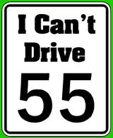
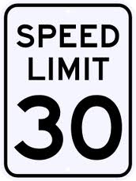
Safety
Operator must adhere to all traffic laws and signs, including posted speed limits
The max speed limit on Texas A&M University Campus is 30 MPH
Notes:
Operator must adhere to all traffic laws and signs, including posted speed limits.. The max speed limit on Texas A&M University Campus is 30 MPH.

Slide 35
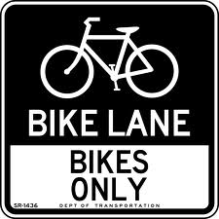
Safety
All SMVs should travel in the right hand lane, unless turning left.
SMVs should not operate in the bike lanes.
Notes:
All Slow Moving Vehicles should travel in the right hand lane, unless turning left. Slow Moving Vehicle’s should not operate in the bike lanes

Slide 36
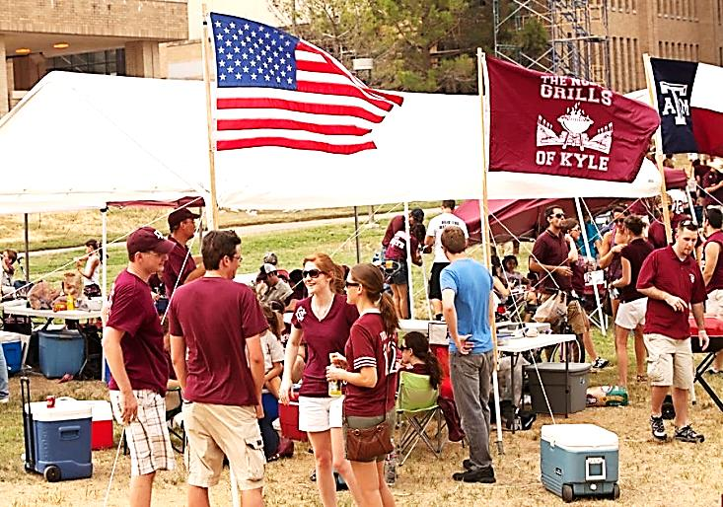
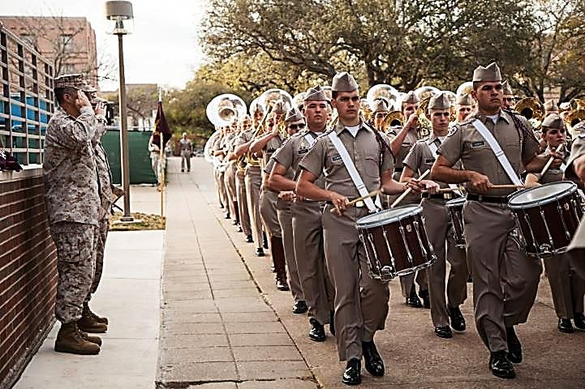
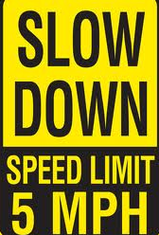
Safety
When moving through congested areas, especially at class change, speed should be no faster than pedestrians walking in the same area or maximum 5mph.
Notes:
When moving through congested areas, especially at class change, speed should be no faster than pedestrians walking in the same area or maximum 5mph.

Slide 37
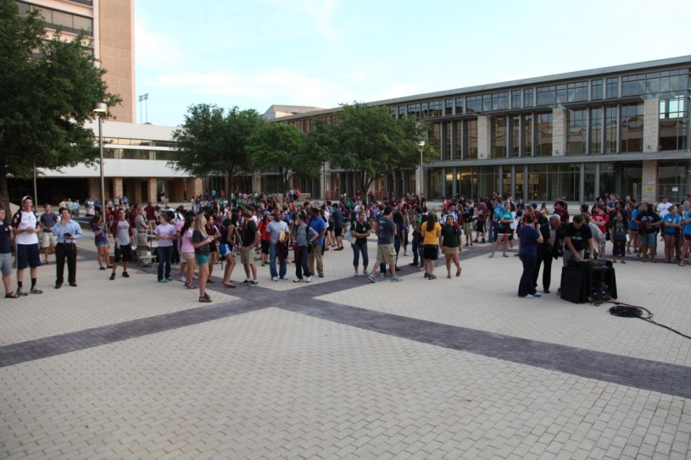
Safety
Exercise extra caution at blind corners and areas with heavy pedestrian and bicycle traffic.
Notes:
Exercise extra caution at blind corners and areas with heavy pedestrian and bicycle traffic.

Slide 38
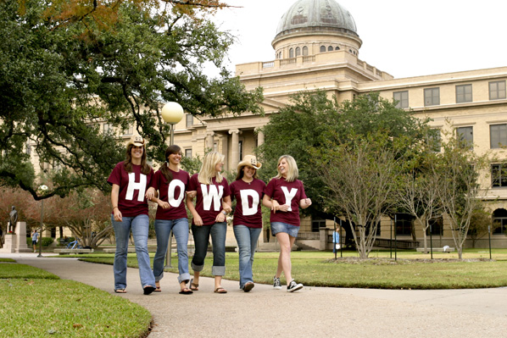
Safety
SMV operators must not block paths or limit pedestrian access on walkways.
Pedestrians have the right of way when on sidewalks and operators must yield to pedestrians and follow no closer than 10’.
Notes:
Slow Moving Vehicle operators must not block paths, limit pedestrian access on walkways. Pedestrians have the right of way on sidewalks and operators must yield to pedestrians and follow no closer than 10’.

Slide 39
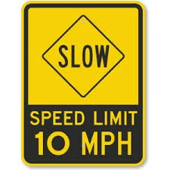
Safety
When operating on sidewalks and grass areas the maximum speed limit for a SMV is 10 mph (5 mph when pedestrians are present).
Notes:
When operating on sidewalks and grass areas the maximum speed limit for a Slow Moving Vehicle is 10 mph (5 mph when pedestrians are present).

Slide 40
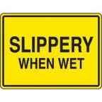
Safety
Reduce speed to compensate for inclines, corners, bumps/rough terrain, pedestrians, and especially on wet/icy conditions.
Notes:
Reduce speed to compensate for inclines, corners, bumps/rough terrain, pedestrians, and especially on wet/icy conditions.

Slide 41
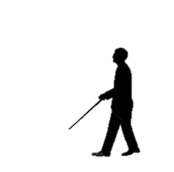
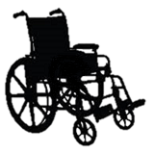
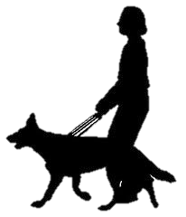
Safety
SMV operators are to be diligent and pay particular attention to the needs of disabled persons, as limitations in vision, hearing or mobility may impair their ability to see, hear, or move out of the way of a SMV.
Notes:
Slow Moving Vehicle operators are to be diligent and pay particular attention to the needs of disabled persons, as limitations in vision, hearing or mobility may impair their ability to see, hear, or move out of the way of an Slow Moving Vehicle.

Slide 42
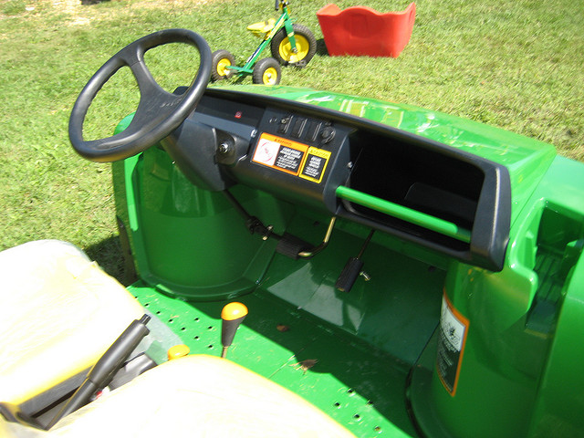
Safety
When Exiting the SMV the operator MUST:
Turn the key to “off” position and remove the key from ignition when unattended
Engage the parking brake
Notes:
When Exiting the Slow Moving Vehicle the operator MUST: Turn the key to “off” position and remove the key from ignition when unattended.
engage the parking brake.

Slide 43
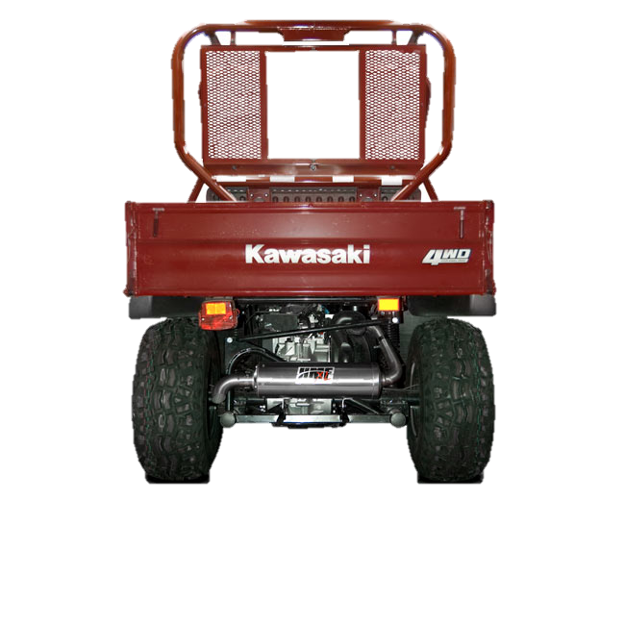
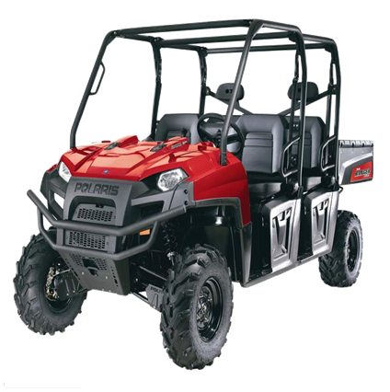


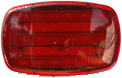
Safety
No SMV shall be operated between dusk and dawn without properly working headlights and taillights.
Notes:
No Slow Moving Vehicle shall be operated between dusk and dawn without properly working headlights and taillights.

Slide 44
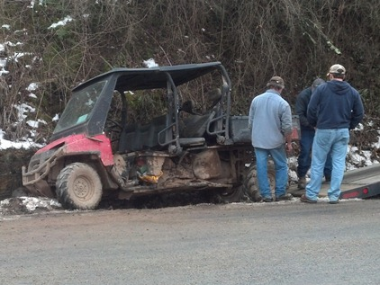
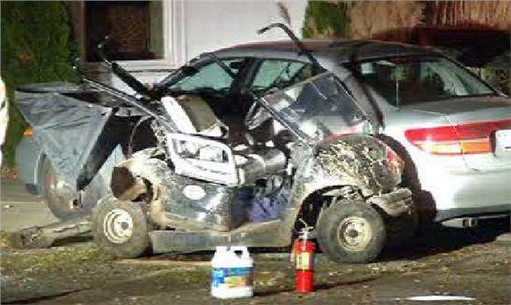
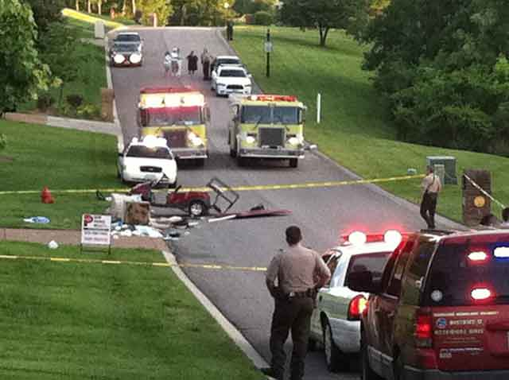
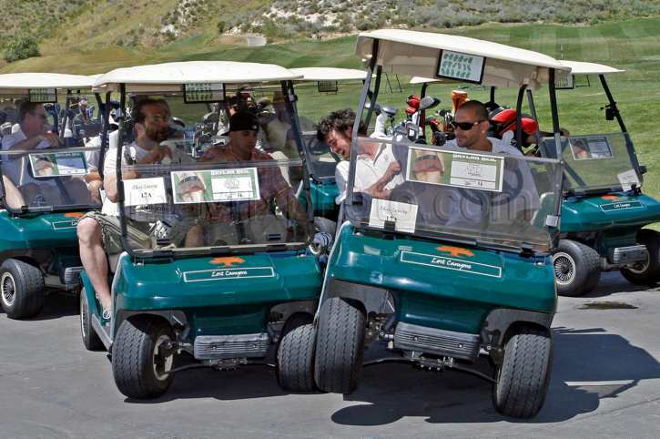
Safety
SMV operators are required to abide by orders/directions from UPD, EHS, Parking/Transportation Services, and building proctors/facility coordinators.
The operator must report an accident to the University Police Department and to the operator’s supervisor.
Notes:
Slow Moving Vehicle operators are required to abide by orders/directions from University Police, Environmental Health & Safety, Parking/Transportation Services, and building proctors/facility coordinators.
The operator must report an accident to the University Police Department and to the operator’s supervisor.

Slide 45

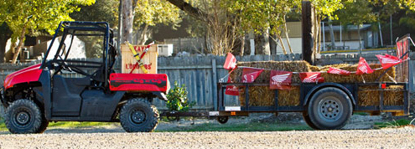
Safety
All SMVs and trailers pulled by a SMV must have clearly displayed the slow moving vehicle reflective triangle on the rear of the SMV and trailer.
Notes:
All Slow Moving Vehicle’s and trailers pulled by a Slow Moving Vehicle must have clearly displayed the slow moving vehicle reflective triangle on the rear of the Slow Moving Vehicle and trailer.

Slide 46

SMV Safety Checklist
https://transport.tamu.edu/alternative/files/SMVSafetyChecklist.pdf
Notes:
https://transport.tamu.edu/alternative/files/SMVSafetyChecklist.pdf

Slide 47
Maintenance
University-owned SMVs are to be maintained in accordance with manufacturer’s specifications.
Departments are responsible for keeping all original equipment and safety features in good working order.
Notes:
University owned Slow Moving Vehicle’s are to be maintained in accordance with manufacturer’s specifications. Departments are responsible for keeping all original equipment and safety features in good working order.

Slide 48





Maintenance
If the SMV is not operating properly, park in a safe location if possible, remove the key and any valuables, and notify your supervisor and Transportation Services for additional assistance with a non-working SMV at (979-845-0057).
Notes:
If the Slow Moving Vehicle is not operating properly, park in a safe location if it is possible, remove the key and any valuables, and notify your supervisor and Transportation Services for additional assistance with a non-working Slow Moving Vehicle at (979-845-0057).

Slide 49
Gas SMV
Follow appropriate requirements for gas-powered SMV storage.
Should be parked outside of buildings unless the building is designated for vehicle storage or repair.
Notes:
Follow appropriate requirements for gas-powered Slow Moving Vehicle storage. SMV should be parked outside of buildings unless the building is designated for vehicle storage or repair.

Slide 50
Electric SMV
Provide flushing and neutralizing capabilities for spilled electrolyte
Verify that a fire extinguisher is nearby
Proper PPE (personal protective equipment) must be worn when you are exposed to an open battery compartment
https://ehsd.tamu.edu/OccSafety%20Documnets/SMV%20gas-battery.pdf
Notes:
Provide flushing and neutralizing capabilities for spilled electrolyte, verify that a fire extinguisher is nearby for fire protection, proper PPE must be worn when you are exposed to an open battery compartment for protection from exposure to battery acid.

Slide 51

Electric SMV
PPE to be used for protection from exposure to battery: Apron, long nitrile gloves, goggles, and face shield.
Notes:
PPE to be used for protection from exposure to battery: apron, long nitrile gloves, goggles, and face shield.

Slide 52

Electric SMV
When charging batteries, the vent caps should be kept in place to avoid electrolytic spray. Ensure the vent caps are functioning as designed. Keep in well ventilated area. The battery cover(s) shall be open to dissipate heat.
Notes:
When charging batteries, the vent caps should be kept in place to avoid electrolytic spray. Ensure the vent caps are functioning as designed.Keep in well ventilate area. The battery (or compartment) cover(s) shall be open to dissipate heat.

Slide 53

Electric SMV
Ensure there is no smoking,
flames, sparks, or electric
arcs in the area. Ensure
lighting is adequate to
perform the task assigned.
Notes:
Ensure there is no smoking, flames, sparks, or electric arcs in the area. Ensure lighting is adequate to perform the task assigned.

Slide 54

Electric SMV
Electric vehicles must be recharged at locations designated for such use.
Power for the
charging station
must be hardwired
(no extension cords).
Notes:
Electric vehicles must be recharged at locations designated for such use, power for the charging station must be hardwired.
The charger must be plugged into the wall socket, it cannot be plugged into an extension cord as a source of power

Slide 55
Parking, Routes, and Access for SMVs
The following outlines procedures for campus parking, travel routes and areas that may or may not be accessed with a SMV.
Notes:
Parking, Routes, and access for Slow Moving Vehicle’s:
The following outlines procedures for on campus parking, travel routes, and areas that may or may not be accessed with a Slow Moving Vehicle.

Slide 56
Parking
SMV’s must not be parked where they block vehicular, pedestrian/bicycle traffic, building entranced/exits, fire department connections, ADA ramps, curb cuts, flower beds or any other location that may present a hazard.
Notes:
Slow Moving Vehicles must not be parked where they block vehicular, pedestrian or bicycle traffic, building entrances and exits, fire department connections, ADA ramps or curb cuts, flower beds, or any other location that may present a hazard.

Slide 57



Improper Parking Areas
Notes:
Improper Parking Areas

Slide 58


Improper Parking Areas
Notes:
Improper Parking Areas

Slide 59
Parking
SMV’s must have a location where they can be safely stored when not in use, a designated parking space or other location approved by Transportation Services with the input from appropriate building proctor(s). Improperly parked SMV may be ticketed, towed, or otherwise disabled by Transportation Services.
Notes:
Slow Moving Vehicle’s must have a location where they can be safely stored when not in use, a designated parking space or other location approved by Transportation Services with the input from appropriate building proctor(s). Improperly parked Slow Moving Vehicle may be ticketed, towed, or otherwise disabled by Transportation Services.

Slide 60


Designated Parking
Notes:
Designated Parking

Slide 61

Routes
Routes on campus
http://transport.tamu.edu/Alternative/maps/SMVpaths.pdf
Notes:
Routes for Slow Moving Vehicles on A&M Campus map http://transport.tamu.edu/Alternative/maps/SMVpaths.pdf

Slide 62

Routes
When approaching a crosswalk, pedestrians have the right of way and SMV operators need to take extra care to ensure they are seen by others before proceeding.
Notes:
When in crosswalk, pedestrians have the right of way and Slow Moving Vehicle operators need to take extra care to ensure they are seen by others before proceeding. Slow Moving Vehicle use in the Wellborn Rd. passageways is authorized with extra caution.

Slide 63

Routes
When on campus use university roadways as the primary route and follow the direction of travel.
Notes:
When on campus use university roadways as the primary route and follow the direction of travel.

Slide 64
Access
SMVs may not be driven on
Wellborn Rd./FM2154
University Dr./Raymond Stotzer Pkwy.
Harvey Mitchel Pkwy./FM2818
George Bush Dr.
Texas Ave./HWY 6 Business
Except while crossing at signalized intersections to contiguous university property.
Notes:
Slow Moving Vehicle may not be driven on:
Wellborn Rd./FM2154
University Dr./Raymond Stotzer Pkwy.
Harvey Mitchel Pkwy./FM2818
George Bush Dr.
Texas Ave./HWY 6 Business
Except while crossing at signalized intersections to contiguous university property.

Slide 65



Access
SMV may be operated on sidewalks and plazas, but the operator must use extreme caution and the speed limit off standard roadways is 10 mph.
Notes:
Slow Moving Vehicles may be operated on sidewalks and plazas, but the operator must use extreme caution and the speed limit off standard roadways is 10 mph.

Slide 66



Access
Slow Moving Vehicle may not operate on sidewalks less than 6’ wide.
Notes:
Slow Moving Vehicle may not operate on sidewalks less than 6’ wide.

Slide 67

Access
Slow Moving Vehicle use in the Wellborn Rd. passageways is authorized with extra caution.
Notes:
Slow Moving Vehicle use in the Wellborn Rd. passageways is authorized with extra caution.

Slide 68



Access
SMVs are prohibited in:
No Wheel Zones
The university may prohibit or further restrict use of SMVs in designated areas and/or times.
Notes:
Slow Moving Vehicle’s are prohibited in: No Wheel Zones
The university may prohibit or further restrict use of Slow Moving Vehicle’s in designated areas and/or times.

Slide 69





Access
Avoid driving on lawns unless performing landscape or other maintenance in that area. Landscape should not be used for “shortcuts”. If wet, do not drive on lawn.
Notes:
Avoid driving on lawns unless performing landscape or other maintenance in that area. Landscape should not be used for “shortcuts”. If wet, do not drive on lawn.

Slide 70
Conclusion
The safe operation of the SMV is paramount. Failure to follow these procedures, render common practices or courtesies, or follow rules of the road for the State of Texas, could result in citation, appropriate disciplinary action, and/or suspension of operator’s SMV driving privileges.
Notes:
The safe operation of the Slow Moving Vehicle is paramount. Failure to follow these procedures, render common practices or courtesies, or follow rules of the road for the State of Texas, could result in citation, appropriate disciplinary action, and/or suspension of operator’s Slow Moving Vehicle driving privileges.

